Slide 1

Churn Prediction – Digital Music

Slide 2

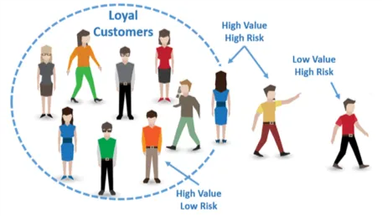
What is a churn?

Slide 3
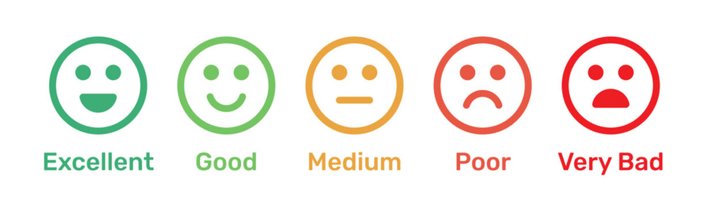
Churn In Music Industry
Churn Rate – Users not renewing the subscription
Less than 3%
Between 3 – 5 %
More than 5%
Revenue growth

Slide 4
Data Source
The Data source contains the following table
https://www.kaggle.com/competitions/kkbox-churn-prediction-challenge/models
https://www.kkbox.com
Table | Description
Train | The train set, contains the user IDs and whether they have churned
Member | User information
User transaction | Transaction of users
User log | Daily user logs describing the listening behaviors of a user

Slide 5

Evaluation Metrics
1) The evaluation metric for this prediction is Log Loss
where i is the given observation/record, y is the actual/true value, p is the prediction probability, and ln refers to the natural logarithm (logarithmic value using base of e) of a number.
2) Apart from Log Loss, Recall and Precision will also be good evaluation metrics since the success of the prediction is based on the churn customer.

Slide 6
Data Wrangling
Data cleaning
Handle missing values (drop or impute values)
Binning age field into age group
Reduce data size by converting the datatype into a minimum range
Data wrangling
Discovering class imbalance
churn class - 9%
Not a churn class – 81%
2) Feature engineering for
the transaction and log
table

Slide 7
Feature Engineering
Transaction
Aggregating using sum, count, and average for numeric feature
Last auto-renew and cancel status.
Flag for auto-renew is true but canceled and not auto-renewed but not canceled
Unique values in the
categorical field
Average and sum of
discount provided for
the user
User log
Read data in chunks and extract each user’s latest active 3-month log
Apply aggregation on the log features based on the function – sum, min, max, count, and average
Merge new features with members and train features to create one final
data frame

Slide 8
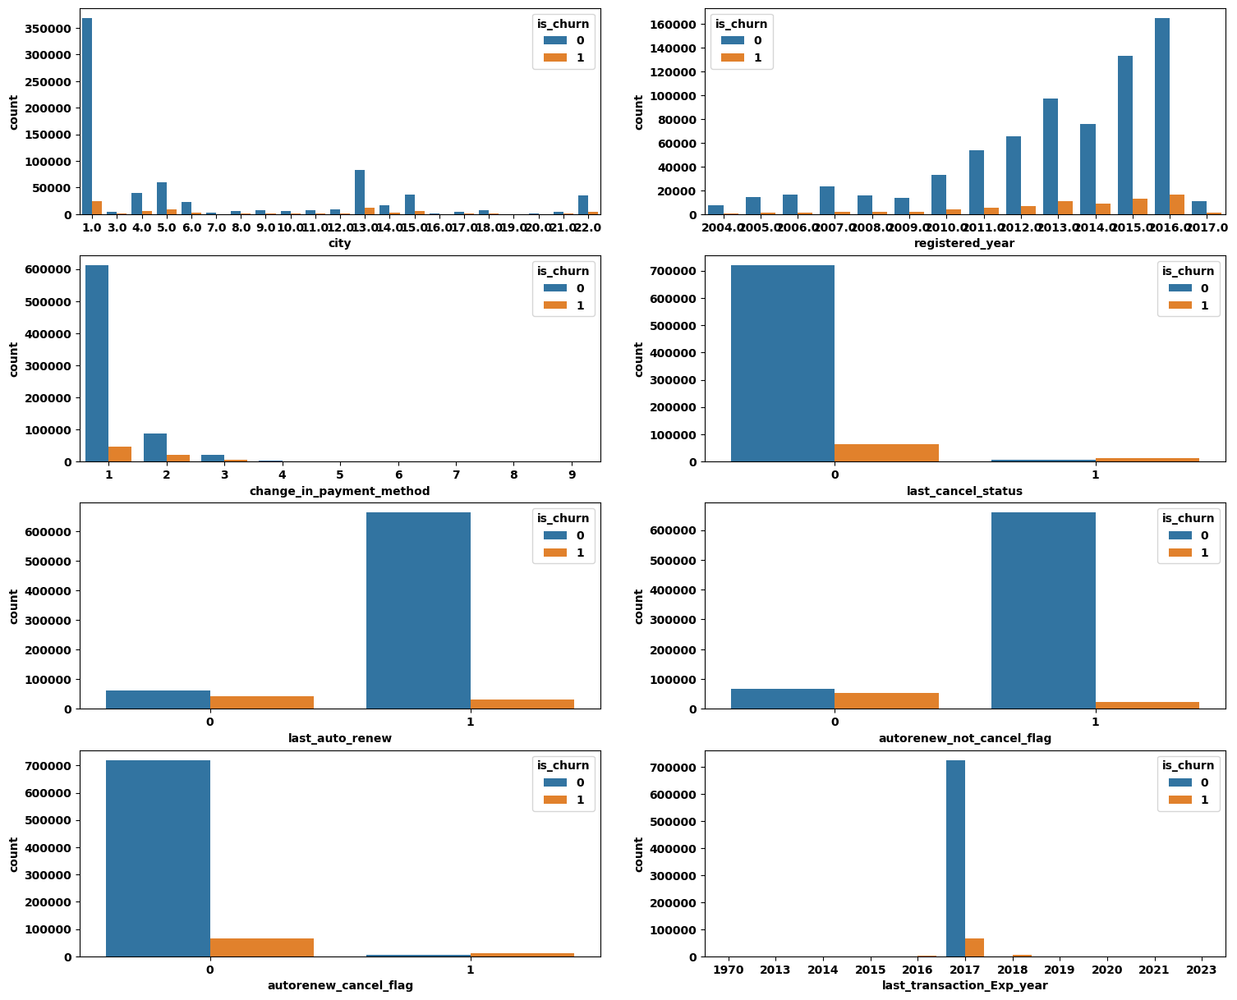
Exploratory Data Analysis
Visualization – Find a Pattern in the data - Categorical

Slide 9
Exploratory Data Analysis
Visualization – Find a Pattern in the data - Categorical

Slide 10
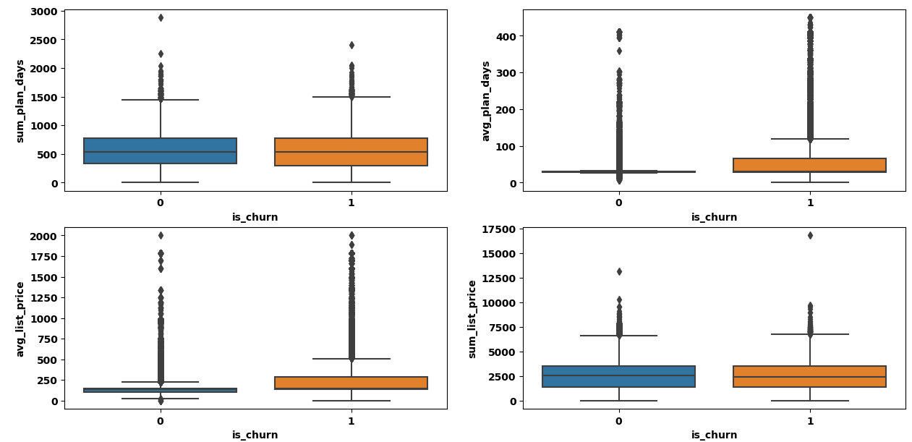
Exploratory Data Analysis
Visualization – Outlier detection- Numerical feature

Slide 11
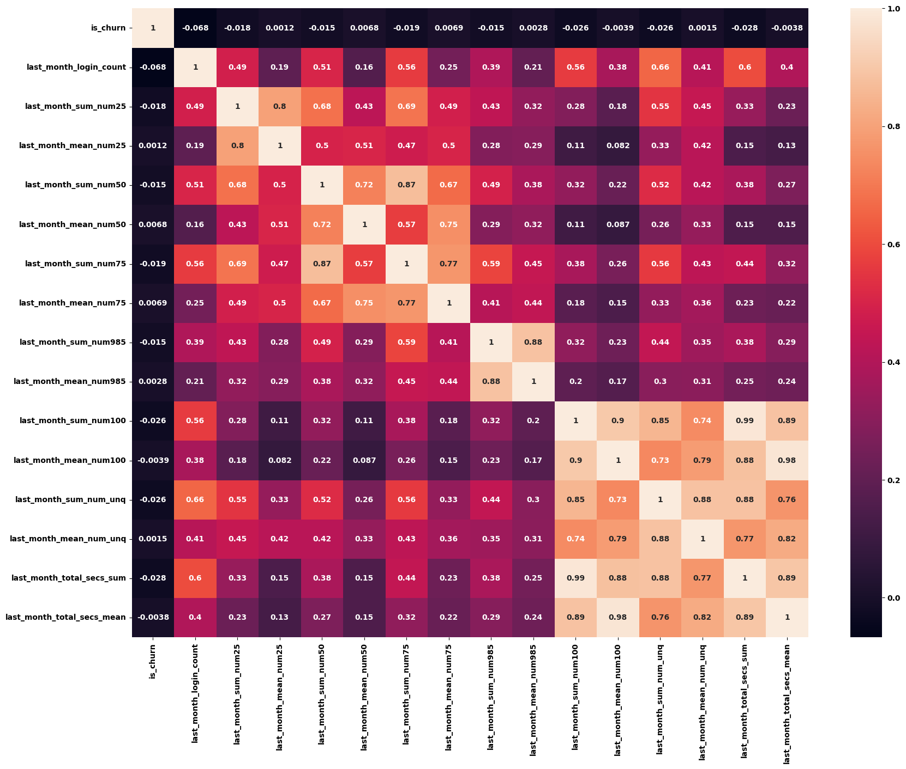
Exploratory Data Analysis
Visualization – feature correlation

Slide 12
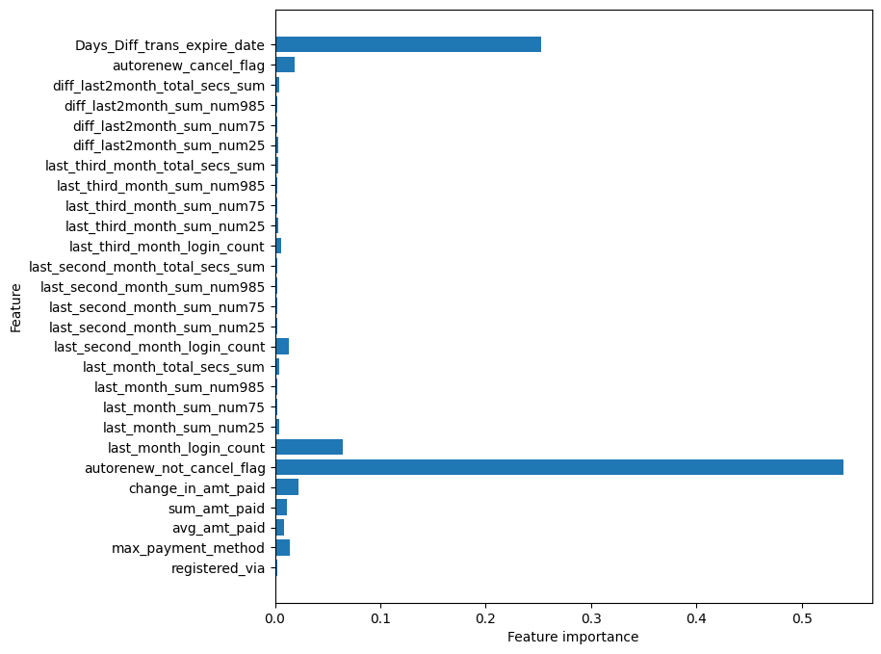
Exploratory Data Analysis
Feature Selection – Recursive Feature Elimination (RFECV)

Slide 13
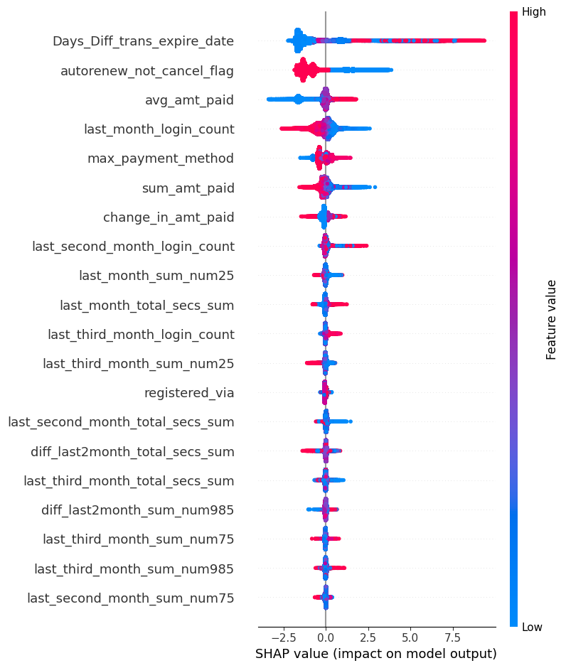
Exploratory Data Analysis
Feature Selection – SHAP values

Slide 14
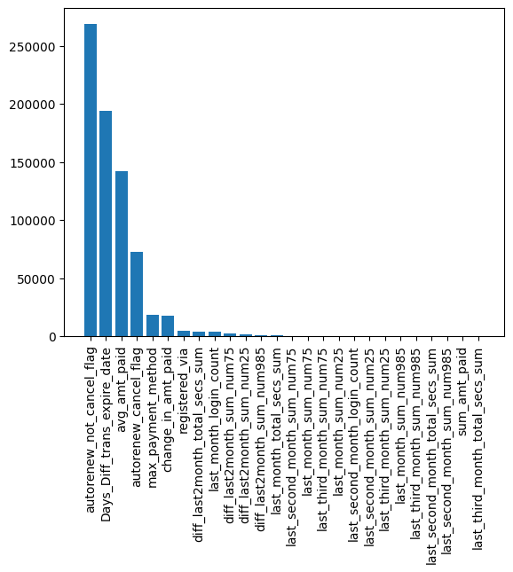
Exploratory Data Analysis
Feature Selection – ANOVA Inferential

Slide 15
Exploratory Data Analysis
Feature Selection – MRMR
Feature Selected - 20
autorenew_not_cancel_flag
diff_last2month_sum_num50
Days_Diff_trans_expire_date
last_cancel_status
avg_plan_days
last_auto_renew
avg_list_price
avg_amt_paid
change_in_payment_method
avg_days_diff_trans_exp
total_transaction
max_payment_method
change_in_amt_paid
diff_last2month_sum_num100
registered_via
change_in_plan_days
diff_last2month_sum_num_unq
city
change_in_list_price
last_month_login_count

Slide 16
Preprocessing
1) Ordinal Encoding for categorical variable
2) Standardizing the numerical features
3) Splitting the data into test and train set

Slide 17
Modeling with all features
Hyperparameter tuning using RandomizedCV
Best Parameter
XGBoost with all features
Random Forest with all features
Compare the metrics and find the best model

Slide 18
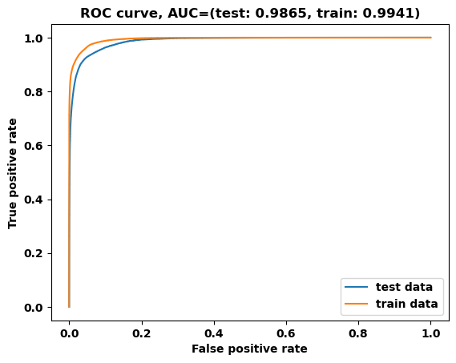
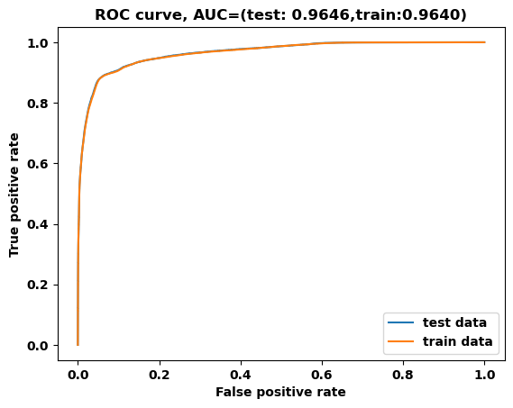
Model Metrics
ROC-AUC curve
Xgboost with all feature
Random forest with all feature

Slide 19
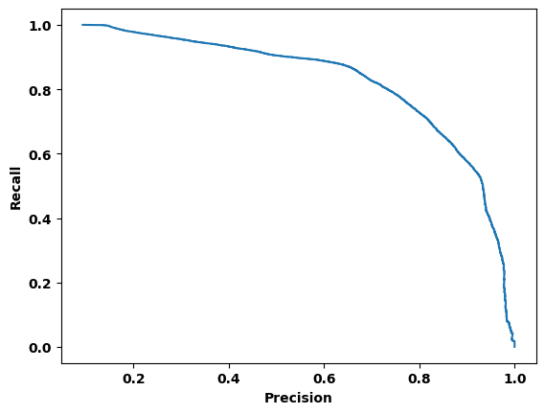
Model Metrics
Precision and Recall curve
Xgboost with all feature
Random forest with all feature

Slide 20
Model Metrics - Comparison
XGBoost vs Random Forest
Performance metrics
Model | Accuracy | AUC | Recall | Precision | F1 | LogLoss
XGBoost - all features | 0.97 | 0.98 | 0.88 | 0.93 | 0.9 | 0.078
RandomForest - all Features | 0.94 | 0.96 | 0.71 | 0.94 | 0.78 | 0.12

Slide 21
Modeling with the best feature
XGBoost - Recursive feature elimination
Optimal feature – 10
XGBoost with the best hyperparameter
XGBoost -MRMR
Optimal feature – 20

Slide 22
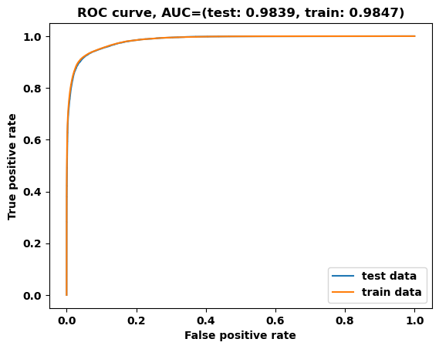
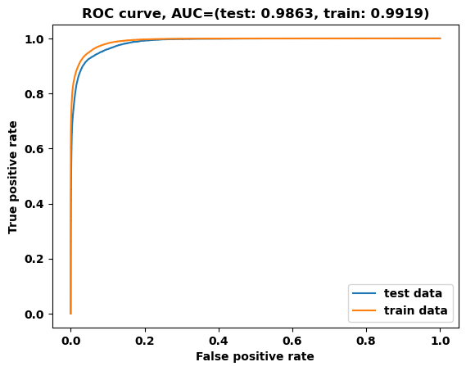
Model Metrics
ROC-AUC curve
Xgboost withRFE
XGBoost with MRMR

Slide 23
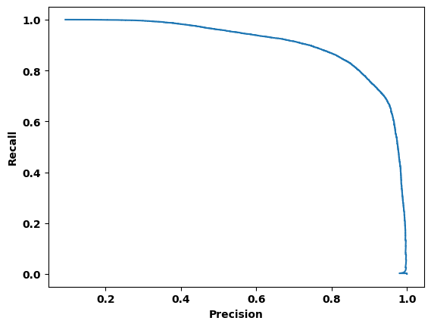
Model Metrics
Precision and Recall curve
Xgboost with RFE
XGBoost with MRMR

Slide 24
Model Metrics
Precision and Recall curve
Xgboost with RFE
XGBoost with MRMR

Slide 25
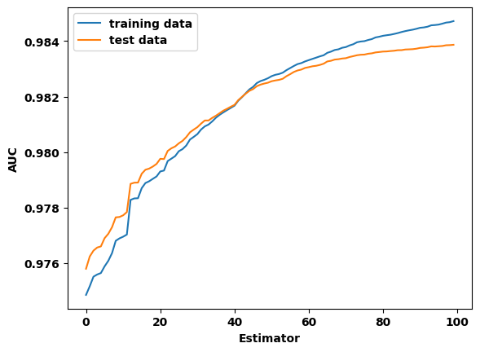
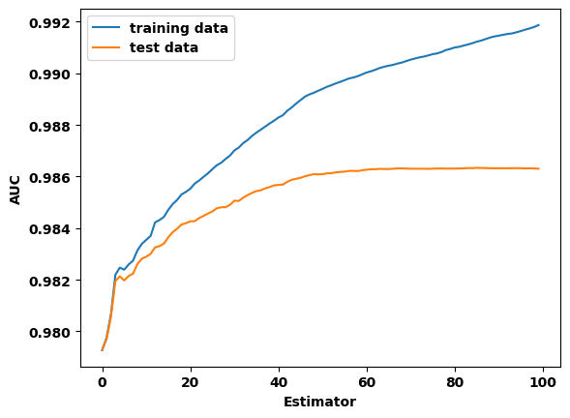
Model Metrics
AUC curve
Xgboost with RFE
XGBoost with MRMR

Slide 26
Model Metrics - Comparison
XGBoost – RFE Vs MRMR
Performance metrics
Model | Accuracy | AUC | Recall | Precision | F1 | LogLoss
XGBoost - RFECV features | 0.96 | 0.98 | 0.88 | 0.93 | 0.9 | 0.08
XGBoost - MRMR features | 0.97 | 0.99 | 0.89 | 0.93 | 0.91 | 0.078

Slide 27
Model Metrics - Comparison
XGBoost – RFE Vs MRMR
Performance metrics
Model | Accuracy | AUC | Recall | Precision | F1 | LogLoss
XGBoost - RFECV features | 0.96 | 0.98 | 0.88 | 0.93 | 0.9 | 0.08
XGBoost - MRMR features | 0.97 | 0.99 | 0.89 | 0.93 | 0.91 | 0.078
XGBoost with MRMR performs slightly better than RFE, hence it is the final model

Slide 28
Recommendation
Get to the root of customer churn by getting customer feedback
Offer personalized and proactive customer communication
Reward customer loyalty
Follow up with customers
Provide customized user experience in the music based on the customer segmentation

